Slide 1


SMART INDIA HACKATHON 2024
TITLE PAGE
Problem Statement ID – SIH1647
Problem Statement Title- Development of Al-ML based models for predicting prices of agri-horticultural commodities such as pulses and vegetable (onion, potato, onion).
Theme- Agriculture, FoodTech & Rural Development
PS Category- Software
Team ID- SIH24HIT31
Team Name (Registered on portal)- TEAM ZENESIS

Slide 2
IDEA TITLE
TEAM ZENESIS
We propose the development of a robust AI/ML-based price prediction system designed to forecast the prices of key agri-horticultural commodities such as pulses (gram, tur, urad, moong, masur) and vegetables (onion, potato). This system will leverage historical price data, weather conditions, and other influential factors to provide accurate price predictions, aiding the Department of Consumer Affairs in strategic market interventions.
Data Collection: Daily price data from the Department of Consumer Affairs and external sources..
Model Training : Using historical data to train, validate, and select the best-performing model.
Prediction & Evaluation : Providing daily and future price forecasts, with ongoing model refinement.
Accurate Price Prediction : Using machine learning models like Random Forest, XGBoost, and LSTM for short and long-term forecasting.
Buffer Stock Management : Assists in strategic decisions for releasing or holding buffer stocks of pulses and onions.
Customizable : The model can be adapted for other commodities and market conditions.
A chatbot for crop price prediction uses machine learning models to forecast future crop prices based on historical data, weather patterns, and market trends, providing real-time insights to farmers and traders.

Slide 3
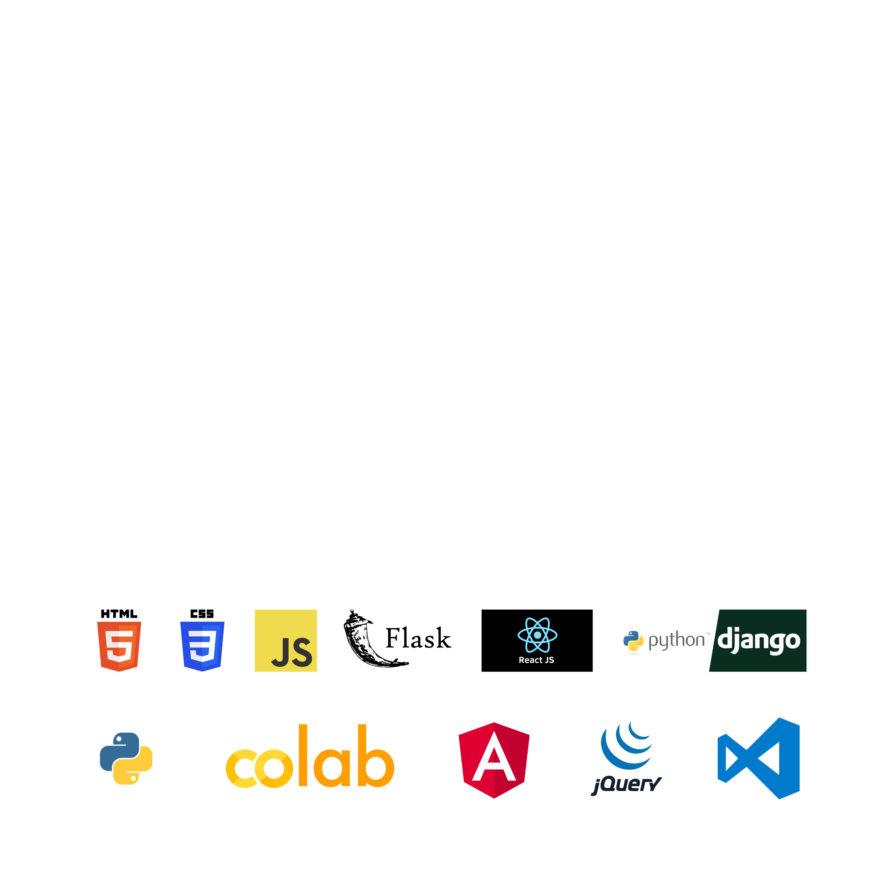
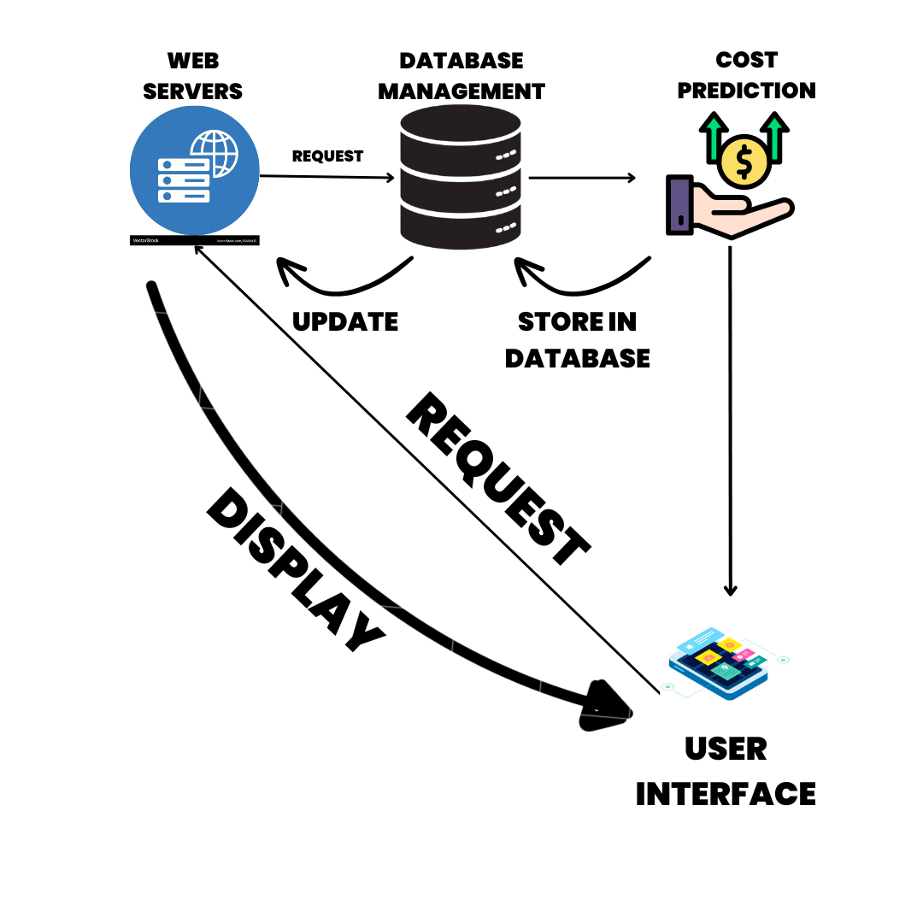
TECHNICAL APPROACH
TEAM ZENESIS
Frontend: HTML, CSS, JavaScript (React or Angular can enhance the experience).
Backend: Python with Flask/Django , Numpy , pandas , werkzeug , Node JS and other libraries and API.
Deep Learning: Convolutional Neural Networks (CNN) for image recognition of plant diseases. Pre-trained models like ResNet, MobileNet can help fast-track development and TENSERFLOW is used too.
Database: Store user data and prediction results in a MongoDB or PostgreSQL database. Cloud Integration: Use AWS/Azure/Google.

Slide 4
FEASIBILITY AND VIABILITY
TEAM ZENESIS
FEASIBILITY OF THE IDEA :
AI-Driven Insights : Predictive analytics for market stabilization and buffer stock management.
Scalability : Expandable to other commodities and adaptable to various market conditions.
CHALLENGES :
Data Inconsistencies : Solution: Integrating third-party APIs (e.g., weather data) to improve accuracy.
Market Volatility : Predictions based on historical data can quickly become inaccurate during periods of high volatility (e.g., during market crashes or demand spikes).
To overcome the challenges of implementing our platform, consider these strategies:
Use reliable APIs with strong documentation: Well-maintained APIs with solid reputation shall be chosen, such as OpenWeather, Alpha Vantage, or Google Maps. These APIs generally offer reliable and timely data.
Data validation and cleaning: Implement checks and validation rules to detect and correct inconsistencies. For instance, missing or out-of-range values can be handled with fallback methods (e.g., interpolating missing data, or using historical data to fill gaps).
Continuous model retraining: Regularly update and retrain your predictive models using the latest data. Use automated pipelines that fetch fresh data, retrain the models, and deploy them with minimal human intervention.

Slide 5
IMPACT AND BENEFITS
TEAM ZENESIS
The potential impact of our platform on the target audience includes:
Government : Informed decisions on price control and buffer stock management.
Farmers/Consumers : Better market predictability, reducing economic shocks.
Scalability : Potential to extend the solution for global markets and more commodities.
The benefits of our platform include:
Informed Market Intervention : Helps the government take timely actions (e.g., releasing stocks) to prevent price spikes or shortages.
Price Stability: Reduces volatility, ensuring more predictable and stable prices for essential commodities.
Farmer Support: Enables farmers to plan crop cycles and sales based on price forecasts, increasing profitability.
Sustainability: Supports better crop planning, reducing waste and promoting food security.
Boosting Agri-Tech: Encourages the adoption of technology and data-driven practices in agriculture.

Slide 6
RESEARCH AND REFERENCES
TEAM ZENESIS
1. Official Resources:- [Smart India Hackathon Website](https://www.sih.gov.in/) for guidelines and problem statements.
2. Government Data:- https://agmarknet.gov.in/ ; https://nhb.gov.in/ .
3. Tech Blogs:- https://www.fao.org/faostat/en/#data/TCL
4. Patent Databases:- Search [Google Patents](https://patents.google.com)

